Slide 1
INVESTMENT ANALYSIS
Name: Shanmukha Sai Prakash Uriti

Slide 2
Abstract and Objective
Spark Funds, an asset management company wants to invest in companies and help it's clients make well timed decisions to match declared financial outcomes.
The objective is to identify the best sectors, countries, and a suitable investment type for making investments. The overall strategy is to invest where others are investing, implying that the 'best' sectors and countries are the ones 'where most investors are investing’.
So , Spark Funds wants to understand the global trends in investments so that investment decisions can be taken effectively.
Spark Funds takes into account two major factors for potential ventures:
It wants to invest between 5 to 15 million USD per round of investment
It wants to invest only in English-speaking countries because of the ease of communication with the companies it would invest in

Slide 3
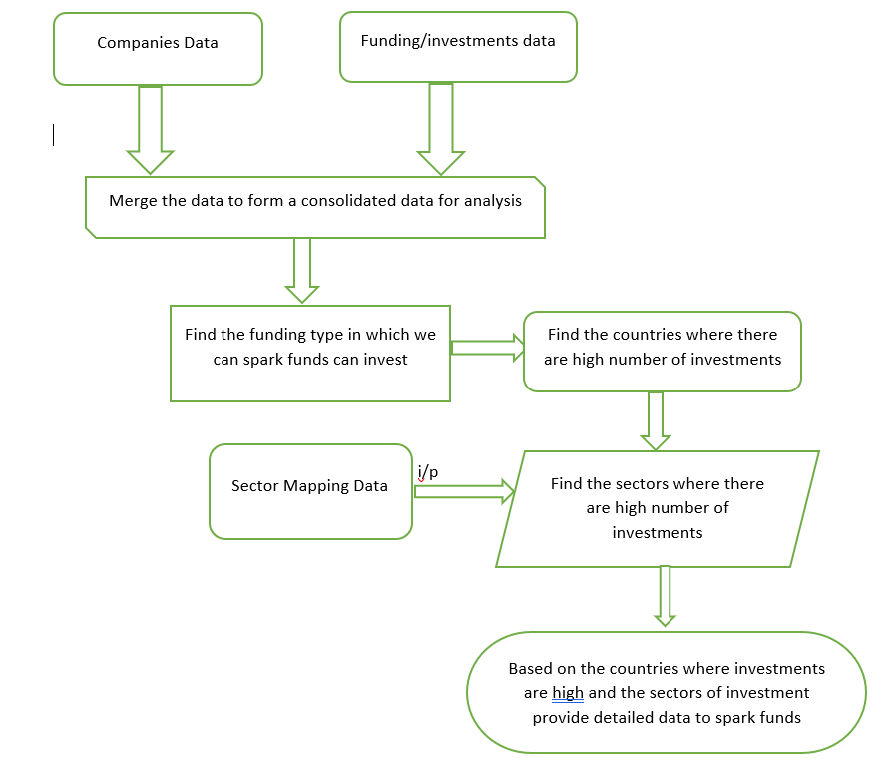
Flowchart for Analysis

Slide 4
Funding Type Identification Analysis
There are many funding types that are available where a company can invest in. Consider the investment types defined as given below:
Seed/angel funding refer to early stage startups whereas venture funding occurs after seed or angel stage/s and involves a relatively higher amount of investment.
Private equity type investments are associated with much larger companies and involve much higher investments than venture type. Startups which have grown in scale may also receive private equity funding. This means that if a company has reached the venture stage, it would have already passed through the angel or seed stage/s.
An analysis has been performed on the four funding types to identify the best funding type for Spark Funds. The results of the same have been represented in graphical format in the following slides.

Slide 5
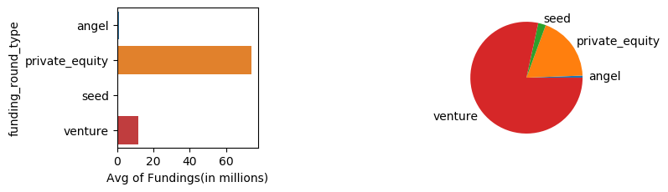
Pictorial Analysis of Funding Types
The bar graph represents the average amount of investments in the four funding types. The pie graph represents percentage of investments in that funding type.
The graphs clearly shows that venture funding type is best suited for needs of Spark Funds.

Slide 6
Country Identification Analysis
Having identified funding round type, the countries where amount invested is high for venture funding type are identified by suitable analysis.
Spark funds wants to invest in countries where investment is high. So top 9 countries where investments are high are the potential prospects.
As Spark Funds wants to invest in English Speaking countries, the top 3 English speaking countries have been identified as suitable . The results have been arrived at on the basis of careful judgement based on the analysis in the following slides.

Slide 7
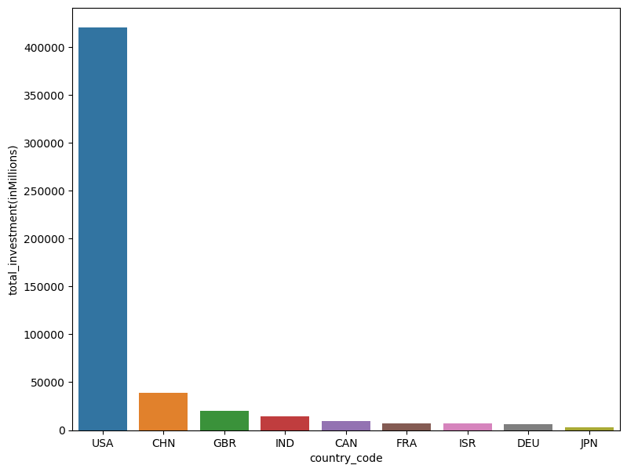
Graph depicting total Investments in different countries
The graph shows the top 9 countries where investments are high.
Based on the graph toop3
Based on the graph the top 3 English speaking countries are USA, GBR, IND

Slide 8
Investment Sector Identification Analysis
The top 3 countries for investment have been identified.
Now we have to analyse the sector in which Spark Funds can invest. There are several hundred sectors available which have been grouped up to eight main sectors.
Now, the sectors where investments are high in the top 3 countries are to be identified. The same has been plotted as a graph.
The top 3 countries and major sectors of investments in those three countries will be reported to Spark Funds to take a decision on investments.

Slide 9
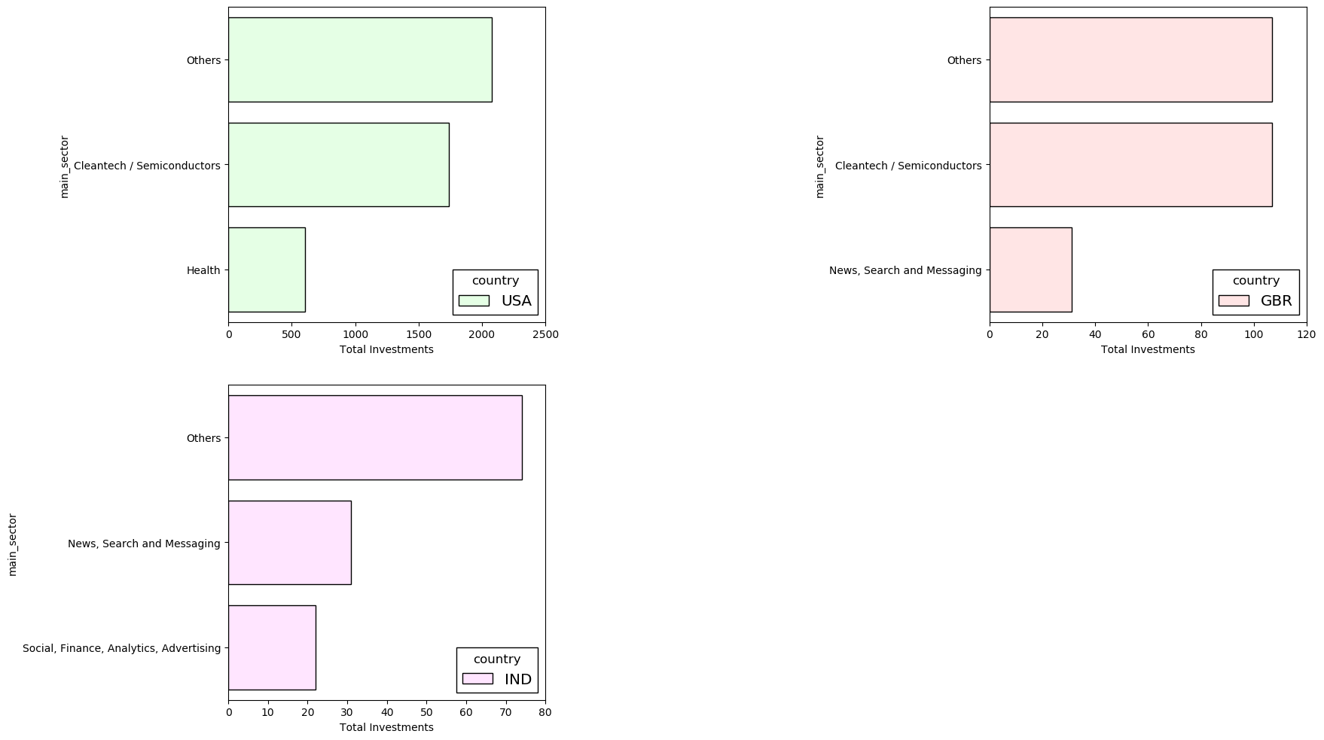
Graph Depicting total investment in different sectors

Slide 10
Conclusion
On the basis of the analysis, Venture funding type is best suited for investment. The countries and sectors where investments are high have been mention below for business decisions to be made:
Country | Most Invested Sector (Amount Invested) | Second Most Invested Sector ((Amount Invested) | Third Most Invested Sector ((Amount Invested)
USA | Others (18551.79M) | Cleantech / Semiconductors (946.23M) | Health (675.17M)
GBR | Others (15981.02M) | Cleantech / Semiconductors (942.81M) | News, Search and Messaging (267.12M)
IND | Others (5455.84M) | News, Search and Messaging (274.14M) | Social, Finance, Analytics, Advertising (183.61M)

